Slide 1

MCA Major Project Mid Term Evaluation
SECURE LINK
Under the guidance of
Dr. Amit Hirawat
Department of Computer Applications
Faculty of Science, Technology and Architecture
Manipal University Jaipur
By
JHANVI KHANNA
23FS20MCA00070
2023-25

Slide 2
Outline
Introduction
Motivation
Process Model
Software Requirement Specification (SRS)
Data Flow Diagram (DFD)
Output
Conclusion
Future Scope

Slide 3
INTRODUCTION
Secure Link is a B2B marketplace app designed to streamline bulk purchasing for wholesalers, retailers, and distributors specializing in cables and connectors. The platform offers a seamless e-commerce experience with a well-organized product catalog, allowing businesses to navigate through categories and subcategories effortlessly.
With advanced order management features such as cart, watchlist, repeat orders, and returns, users can efficiently handle their procurement process.
Secure Link also provides flexible payment options, including the ability to place orders without upfront payment, along with automated pricing, cashback offers, and discount vouchers to enhance cost efficiency. Integrated logistics support ensures smooth transportation, while real-time notifications keep users updated on their orders.
Additionally, the app features multi-login and OTP-based authentication for secure access, along with a dedicated help center and profile management to enhance user experience. By leveraging Secure Link, businesses can optimize their supply chain operations and improve their purchasing efficiency.

Slide 4
Motivation
The idea behind developing Secure Link stems from several challenges and inefficiencies in the traditional B2B wholesale industry, especially for cables and connectors.
Fragmented Supply Chain – Many wholesalers, retailers, and distributors face difficulties in sourcing products efficiently due to a lack of a centralized platform.
Time-Consuming Ordering Process – Traditional procurement methods involve manual negotiations, phone calls, and emails, making bulk ordering slow and inefficient.
Lack of Price Transparency – Businesses often struggle with inconsistent pricing, hidden costs, and limited access to bulk discounts.
Limited Payment Flexibility – Many B2B transactions require upfront payments, restricting purchasing power and business growth.
Logistics and Order Tracking Issues – Many businesses do not have visibility into the shipment status, leading to delays and uncertainty.
Digital Transformation in B2B – With the rise of e-commerce, businesses demand seamless, automated, and scalable solutions for procurement.

Slide 5
Process Model
Software Requirement:
Operating System: Windows/Linux/mac OS
Backend: Java, Spring Boot
Frontend: React JS / Flutter
Database: MySQL
Server: AWS Cloud
Version Control: Git
Testing Tools: Selenium, JMeter 2.
Hardware Requirements:
Server: 4 Core CPU, 16 GB RAM
Development Machines: Minimum 8 GB RAM, Intel i5/i7 processor
Mobile Devices: Android (9+), iOS (13+)

Slide 6
Software Requirement Specification (SRS)
https://docs.google.com/document/d/1NdTLJ6YKIENdegPpboQg6oKoNdSursq0/edit?usp=sharing&ouid=109700981304907089612&rtpof=true&sd=true

Slide 7
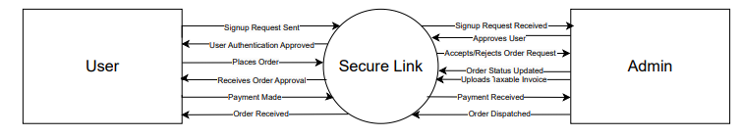
Data Flow Diagram (DFD)
Zero Level DFD

Slide 8
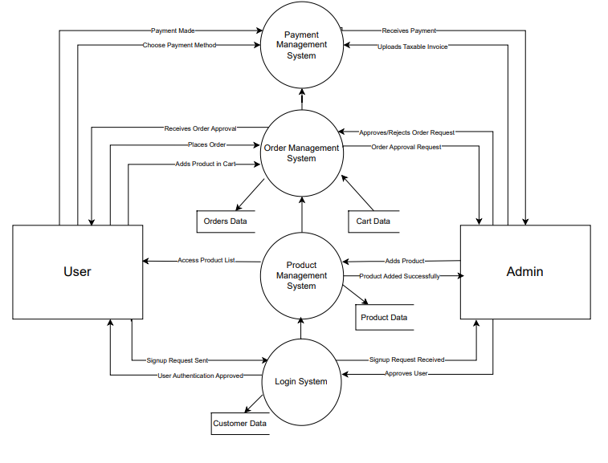
First Level DFD

Slide 9
OUTPUT
PVD Document:
https://docs.google.com/document/d/1GZt9DQ52Xlaa9yz8Svl_LHo2KctTVqf5/edit?usp=sharing&ouid=109700981304907089612&rtpof=true&sd=true
BRD Document:
https://docs.google.com/document/d/1qLdQICMnZu1NlhwYS4uClENzqbB3mCm_/edit?usp=sharing&ouid=109700981304907089612&rtpof=true&sd=true
Figma Link:
https://www.figma.com/proto/40tRqh1I9ALUh0jkvSd36g/Secure-Link---Admin?node-id=0-1&t=nGyJ6IC4i995sbsK-1

Slide 10
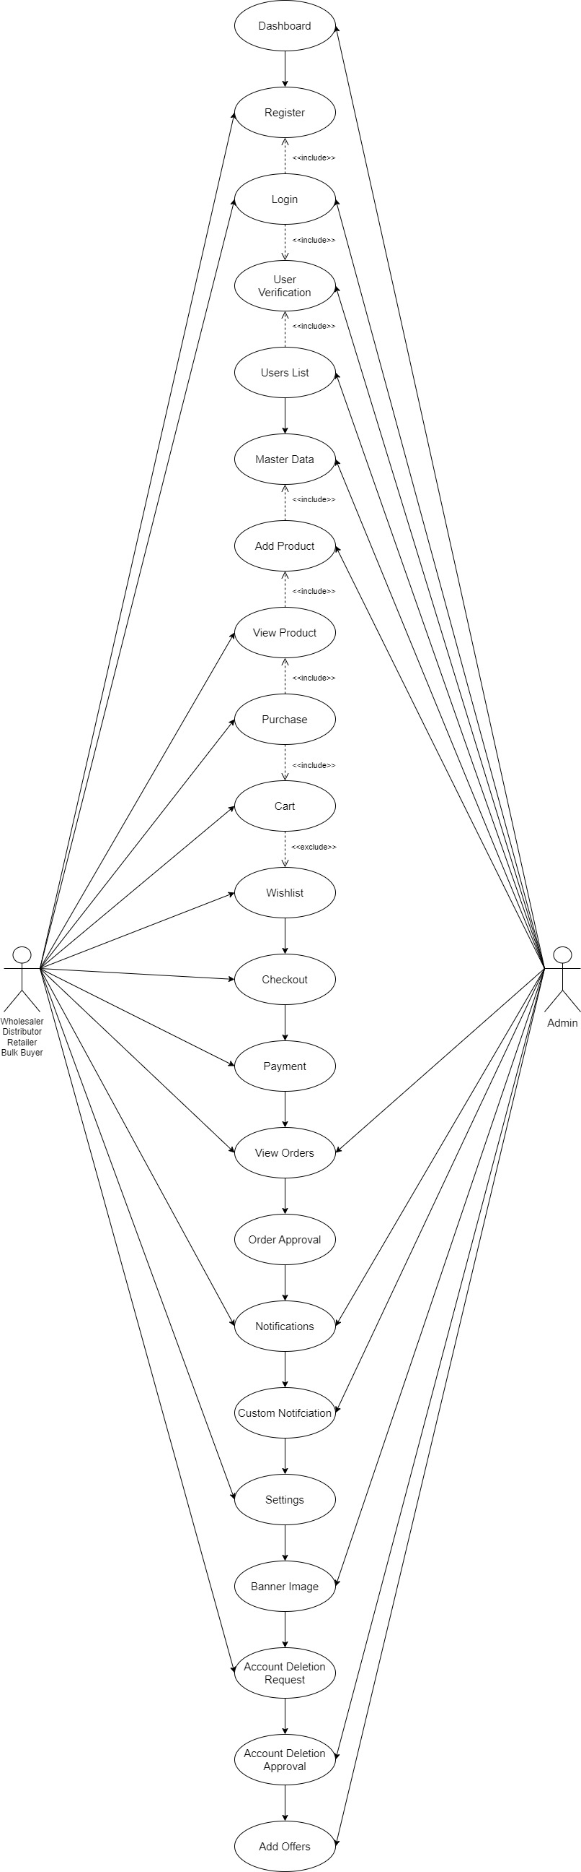
Use Case Diagram

Slide 11
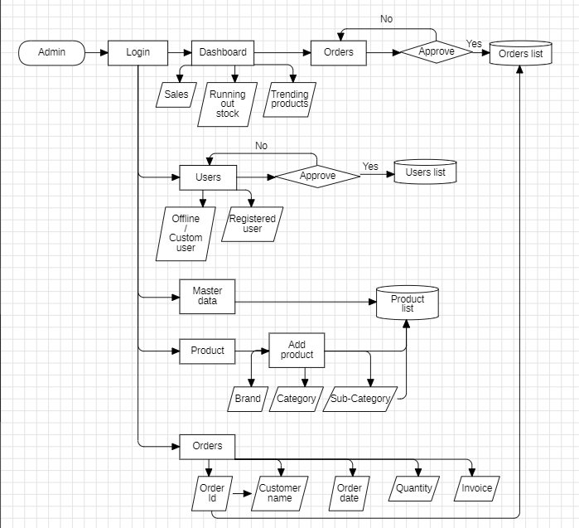
Admin Flowchart

Slide 12
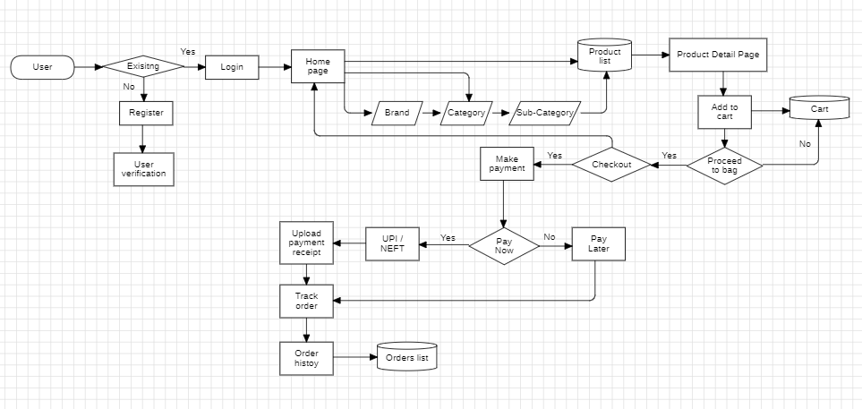
App Flowchart

Slide 13
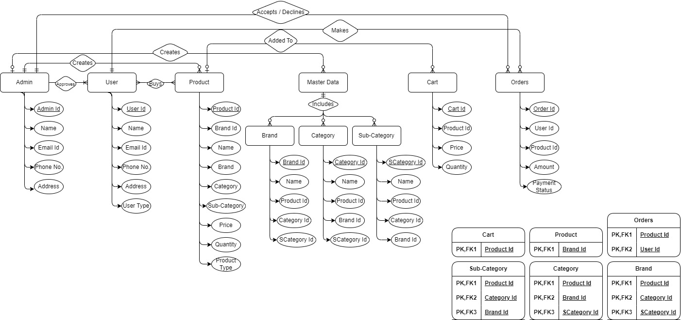
ER Diagram

Slide 14
CONCLUSION
Secure Link successfully streamlines B2B transactions by providing a seamless marketplace for wholesalers, retailers, and distributors. With its comprehensive features—including an intuitive e-commerce system, secure authentication, efficient order management, and flexible payment options—Secure Link enhances business operations and fosters a more connected supply chain. The platform’s user-friendly design, automated pricing, and promotional features ensure a smooth purchasing experience while driving growth for businesses. As Secure Link continues to evolve, it remains committed to optimizing B2B interactions, expanding its offerings, and adapting to market demands to support its users effectively.

Slide 15
Future Scope
AI-driven recommendations for personalized user experience.
Integration with ERP & CRM systems for seamless business operations.
Blockchain-based secure transactions for transparency and trust.
Expanded payment options, including BNPL and credit-based purchasing.
Real-time logistics tracking and AI-driven demand forecasting.
Multilingual & multi-currency support for global reach.AR-based product visualization for better purchasing decisions.
Advanced data analytics for business intelligence and insights.
Sustainable practices with eco-friendly packaging and logistics.
API integrations to enhance marketplace capabilities and scalability.

